Slide 1
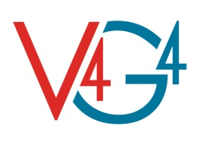


The ALLEGRO design and safety studies
V4G4 Centre of Excellence – ALLEGRO Project
CATHARE Gas Seminar
Saclay, 25-26 January 2018
A. Vasile
CEA

Slide 2



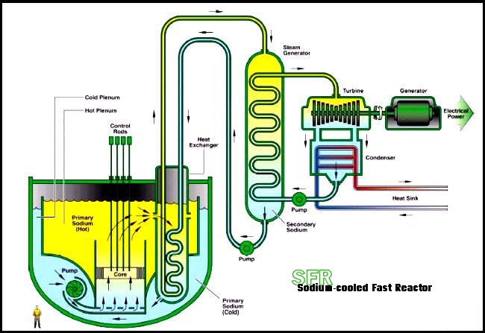
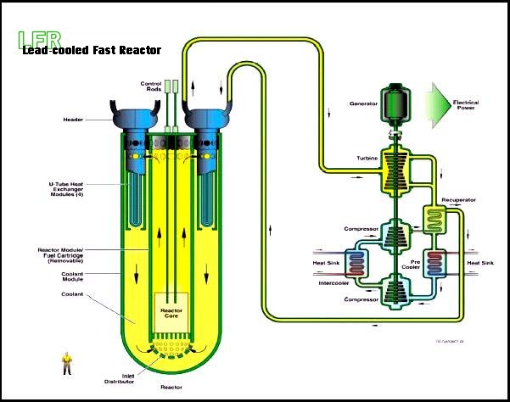
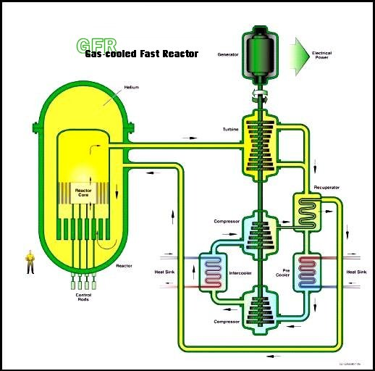
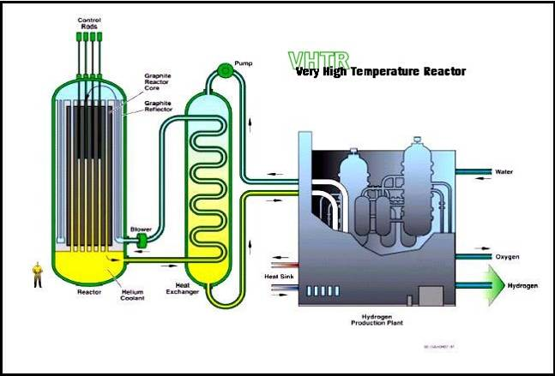
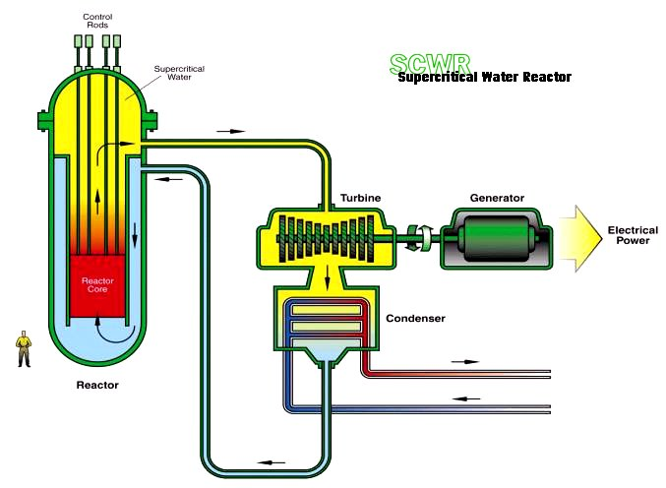
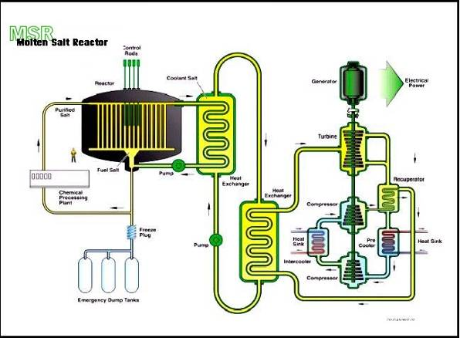
GIF Selection of six Nuclear Systems
Sodium Fast Reactor
Lead Fast Reactor
Gas Fast Reactor
Very High Temperature Reactor
Super Critical Water Reactor
Molten Salt Reactor
Recognition of the major potential of fast neutron systems with a closed fuel cycle
for breeding (fissile re-generation) and waste minimization (minor actinide burning)

Slide 3
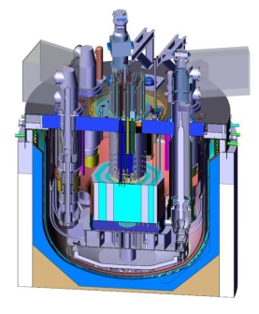
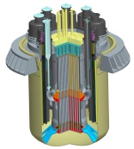
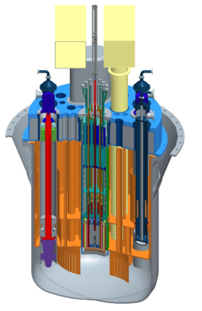

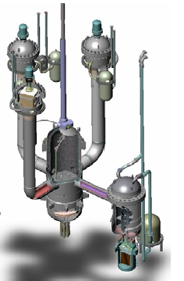
R&D on Fast Reactors in Europe
ESNII
Reactors under development
ASTRID
SFR
Prototype
1500 MWth / 600 MWe
Sodium
MOX
ALFRED
LFR Demonstrator
300 MWth / 120 MWe
Lead
MOX
MYRRHA
Flexible Irradiation Facility
100 MWth
Lead-Bismuth
MOX
ALLEGRO
GFR
Experimental reactor
75 MWth
Helium
MOX/UOX, then UPuC

Slide 4

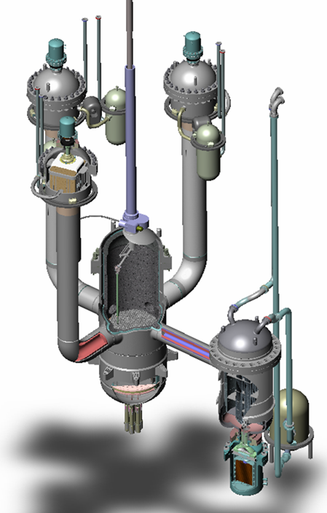
GFR and ALLEGRO
V4G4 Centre of Excellence
Hungary, Czech Republic, Slovakia and Poland
From 2017: CEA Associated Member
Euratom countries
GFR 2400 MWt
reference concept
Allegro 75 MWt

Slide 5


Objectives of ALLEGRO
  Demonstration of key GFR technologies:
      Development of ceramic fuels
      Helium circuits and components
      Decay heat removal
  Fast neutron irradiation capacity
  Potential for coupling with high temperature components or direct use of heat
  Development of safety standards for GFRs

Slide 6
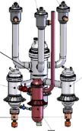
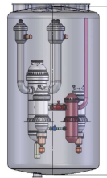
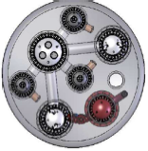
ALLEGRO Main characteristics
  75 MWth nominal power
  Primary He (260-530°C core inlet-outlet, 70 bars)
  2 Secondary pressurized water loops, option for an additional high temperature gas loop.
  Tertiary athmospheric air (No power conversion)
  3 DHR loops (Primary He / Water HX)
DHRS
RPV
Guard containment
IHX He/water
Main blowers
Additional He/He IHX

Slide 7
ALLEGRO Main characteristics
DHR circuits
(1/3)
Primary circuits
(1/2)
Secondary circuits
(1/2)
65 b
Pressurizer
Water pool
Water
DHR HX
10 b
197 °C
He
DHR Valve
530 °C
DHR Blower
70 b
Core
Guard vessel
Primary
Valve
He
75 MWth
127 °C
Aero
65 b
Air Blower
Water Pump
260 °C
Primary Blower
Nitrogen accumulators (1/3)
Pony motor

Slide 8
ALLEGRO CORE an systems feasibility studies
Trnava
Loop
S-ALLEGRO
Loop
Code to code thermal hydraulic benchmark
(VINCO EU project)
Code to code neutronic benchmark
(VINCO EU project)
Initial reference core and systems design
Core/System feasibility studies
CATHARE
RELAP
MELCOR
UOX core neutronic feasibility study
No
Selection of transients
Acceptance criteria
Yes
Detailed UOX core neutronic,
thermalhydraulic,
mecanic,
fuel behaviour calculations and optimization
Detailed MOX core neutronic,
thermalhydraulic,
mecanic,
fuel behaviour calculations and optimization

Slide 9
VINCO Thermal Hydraulic Benchmark
Codes used
 | MTA EK (HU) | NCBJ (PL) | UJV (CZ) | VUJE (SK)
CATHARE 2 | ● | ● |  | ●
RELAP 3D |  |  |  | ●
MELCOR 2.1 |  |  | ●
Calculated transients
 | Case 1 | Case 2
Initial conditions | Nominal | Nominal
Transient | LOCA 3' breach in primary cold leg. | SBO Total loss of electricity.

Slide 10
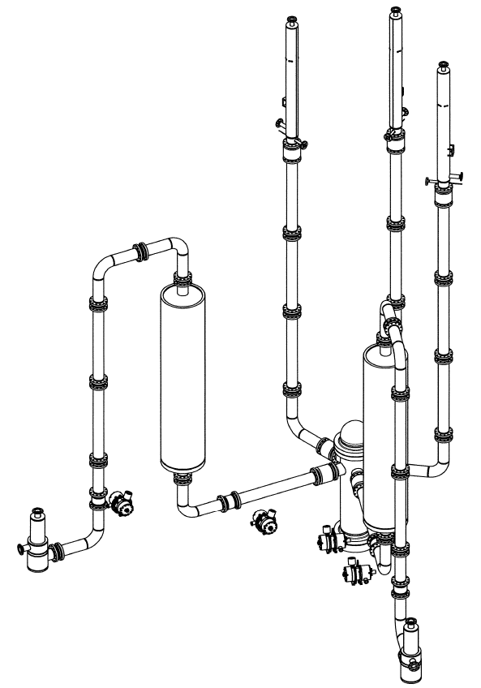
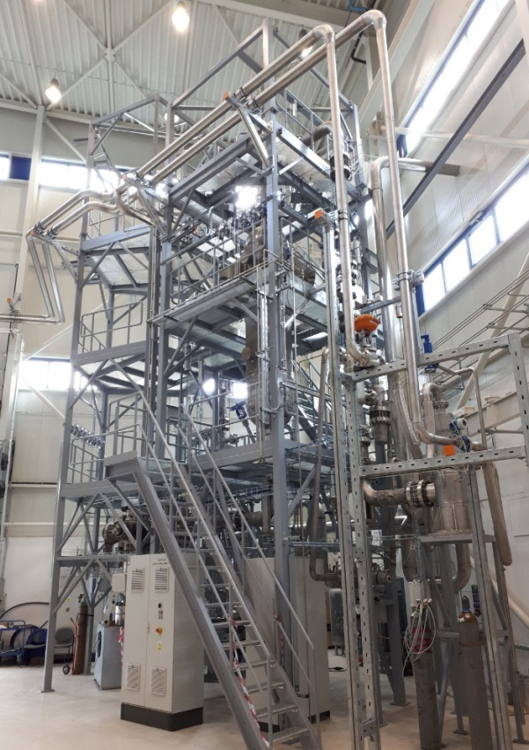


He-loop S-ALLEGRO (CZ)
Phase I
(SUSEN 2017)
ALLEGRO mockup

Slide 11
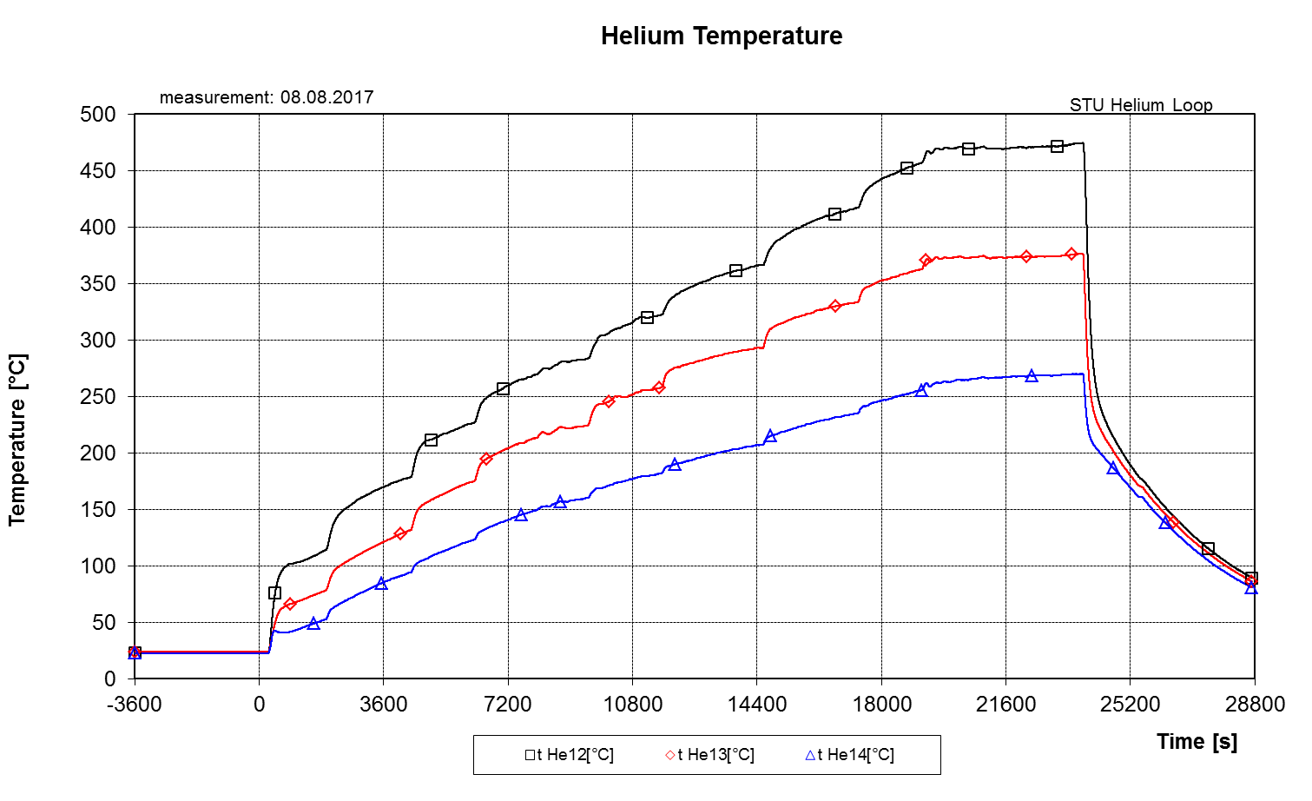
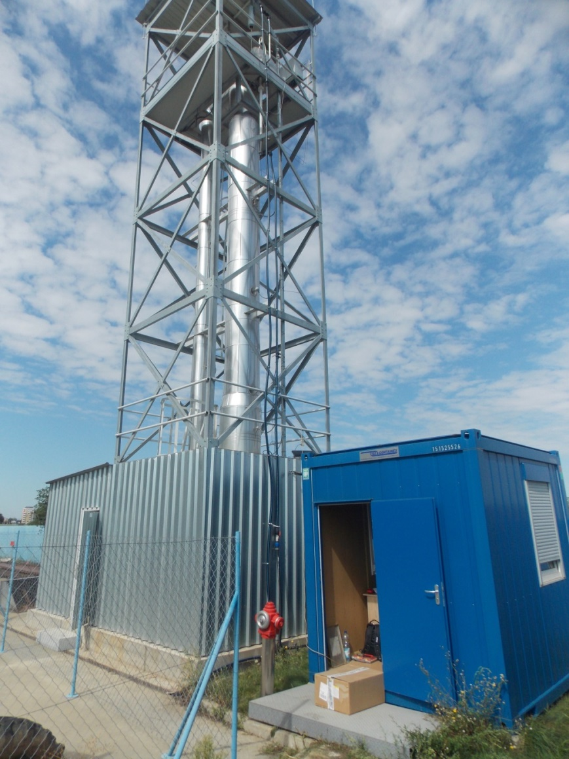
STU-loop Trnava (SK): External view

Slide 12
CATHARE calculations of protected transients on the reference 75 MW design. Transients |  | Additional failures
 |  | None | 1 Pony motor off | Secondary pumps off | Tertiary blowers off | 1 DHR loop valve | 1 primary valve | 1 DHR loop | 1 DHR blower | Guard vessel
Pressurized | LOFA Primary | ✓ | ✓ | ✓ | ✓ | ✓
 | LOHS | ✓ |  |  |  |  | ✓ |  | ✓
 | Internal breach | ✓ | ● | ✓ |  | ✓
 | SBO | ✓ | ✓ |  |  | ✓ |  | ✓
 | Water ingress in the core | ✓
LOCA | Primary 3' | ✓ | ✓ | ✓ | ✓ | ✓
 | Primary 10' | ✓ | ✓ | ✓ | ✓ | ✓ |  |  |  | ✓
 | Secondary 10' | ✓ | ✓ | ✓ | ✓ | ✓ | ✓
 | DHR loop 10' | ✓
 | Crossduct rupture | ✓
 | Total section break colduct | ✓
 | Primary 1' + SBO | ●
✓ Criteria satisfied
● Criteria not satisfied
Class 3
10-2/y - 10-4/y
Accidents
Plant restart required
735 °C
Class 4
10-4/y - 10-7/y
Hypothetical accidents
Plant restart not required
850 °C
DEC
Design Extension Conditions
1300 °C
Safety classes and criteria for maximum
SS cladding temperatures

Slide 13
Improvement of DHR capabilities in case of LOCA+SBO
      Core design
    Decrease total power (Reference: 75 MW)
    Decrease power density (Reference 100 MW/m3)
    Increase thermal inertia (Reflectors…)
    Decrease pressure drop to enhance natural convection
    Cladding material for the start-up oxide core (Reference SS)
      Optimization of DHR Systems
    Coupled primary-secondary turbomachines
    Injection systems, Heavy gas accumulators
      Guard containment
    Guard containment + Conventional containment building as back-up
    Optimization of guard containment to assure the required back-up pressure to maintain an efficient cooling by natural convection.
    Provisions to assure that a double failure (primary circuit and guard containment) is impossible or very unlikely
CATHARE, RELAP an MELCOR system codes are being used for system analysis

Slide 14
1 inch LOCA + BLACKOUT
Effect of power and power density reduction on the maximal peak cladding temperature
CATHARE calculations

Slide 15
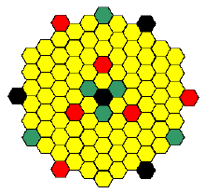

Improvement of DHR capabilities in case of LOCA+SBO
      First core of ALLEGRO must:
        Rely on already existing technologies.
        Be used for the development of advanced GFR ceramic
        fuel by irradiation on some dedicated positions.
      MOX fuel was considered in previous stages of
      the project. "CEA2009" MOX core main characteristics:
        75 MW
        100 MW/m³
        1 batch, 660 fped
        25 % Pu
        Carbide experimental S/As:
          8,4 10¹⁴ n/cm²/s max fast flux (GFR2400 – 30%)
          1,8 at% max burn up (GFR2400 – 10%)
          15 dpa SiC max dose (GFR2400 – 32%)
      Design options for make a LEU UOX core feasible
        Increase the number of fuel assemblies
        Increase the core hight
        Increase to pin diameter.
Experimental
MOX
Control
Shutdown

Slide 16
SUMMARY
      The ALLEGRO Design and Safety Roadmap was defined and is being implemented by the V4G4 partners.
      Benchmarking VINCO activities by comparing thermalhydraulic system codes are being performed in support of the improvement of the design.
      ALLEGRO design is being improved to increase the decay heat removal capabilities in case of a very unlikely transient of loss of coolant accident cumulated with a total station blackout.
      Feasibility of a UOX stat-up core is being investigated

